Slide 1

Overview of Association analyses and causal inference in health study
Prof. Xiaochen Zhang, Xian Zhang

Slide 2
Results
Conclusions

Slide 3
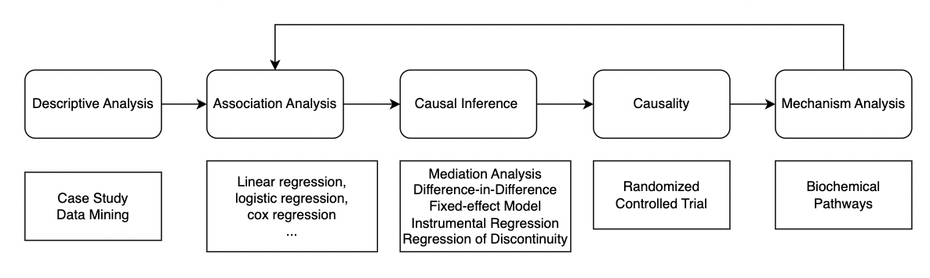
Causal pathway/Causal Chain in Health Study

Slide 4
Results
Conclusions
Results from base-case analyses
+
Results are unbiased;
Results not sensitive to measurement;
Results are robust;
Results are supported by proven Mechanism
……
Discussion
Compare results with other literature;
Discuss mechanism……

Slide 5
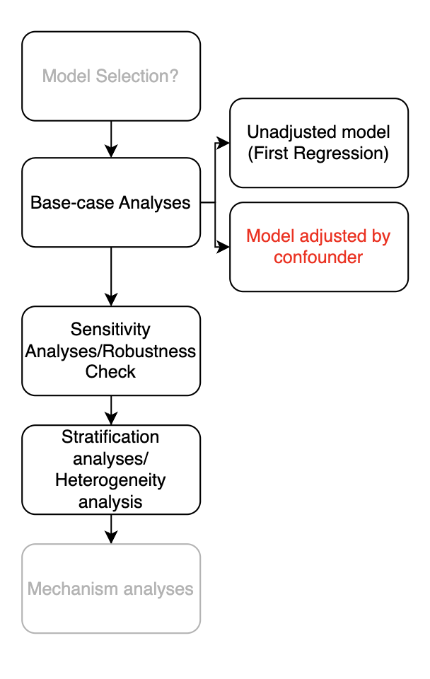
Analyses progress
1. Model Selection
2. Adjust by confounders
3. Sensitivity Analyses
4. Stratification Analyses
5. Mechanism Analyses

Slide 6
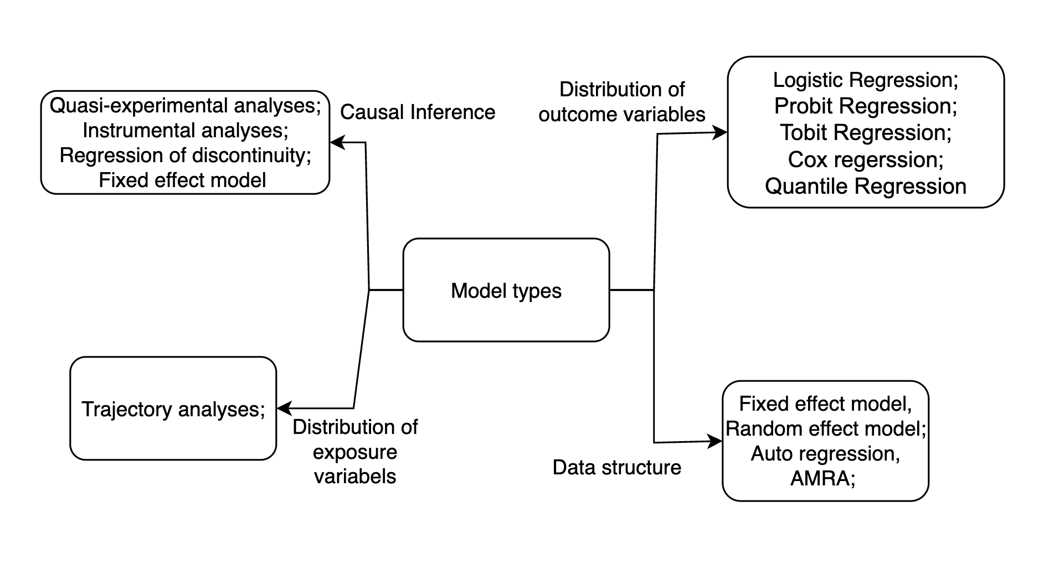
1. A way to understand Model Selection for beginners: model types

Slide 7
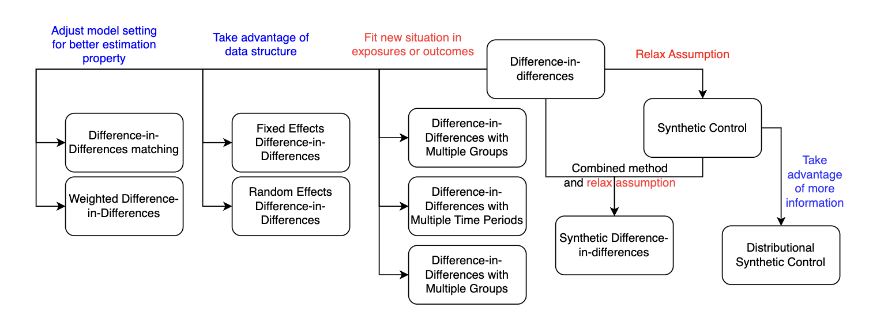
1. A way to understand Model Selection for beginners: within a certain type– using DID family as an example

Slide 8
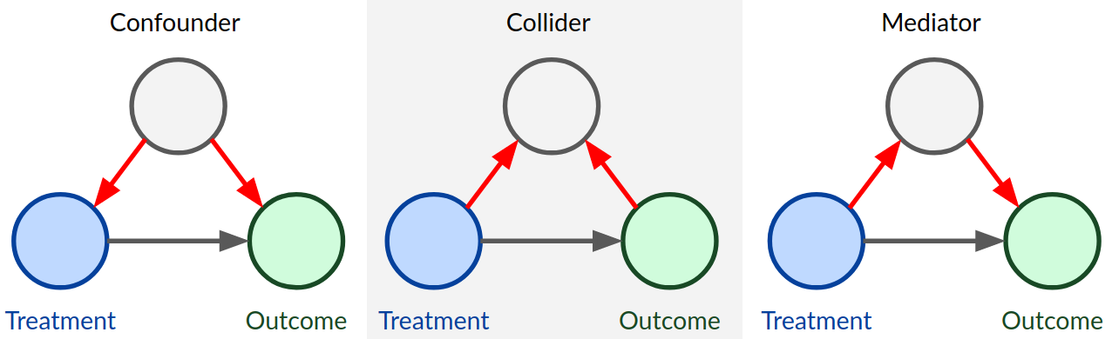
2. Adjust model by confounder: Common situations that determine whether you should control or condition a variable.

Slide 9
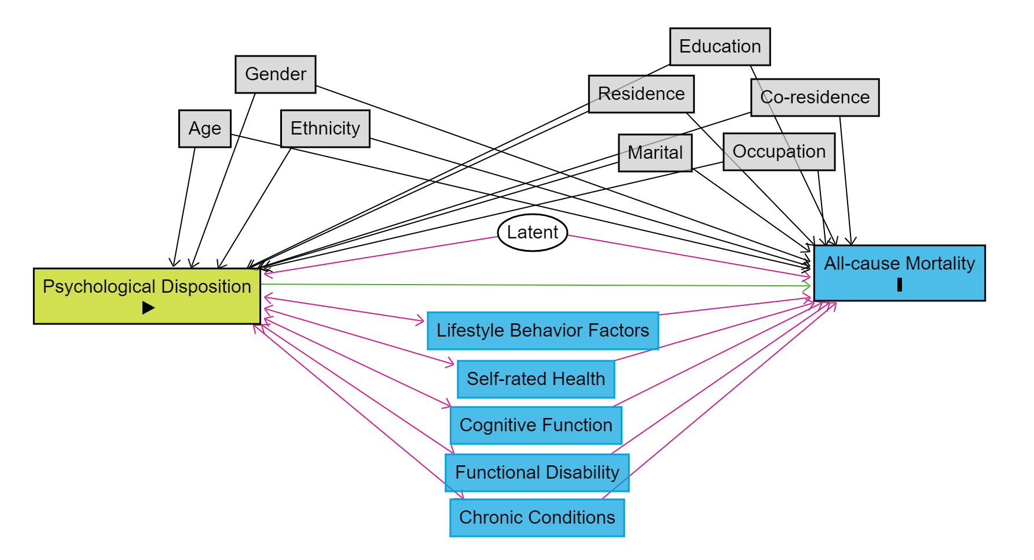
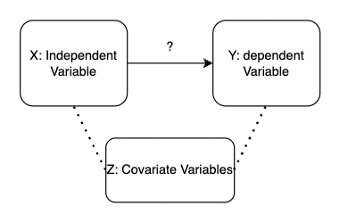
2. Adjust model by confounder: Unadjusted model and Model Adjusted by confounders

Slide 10
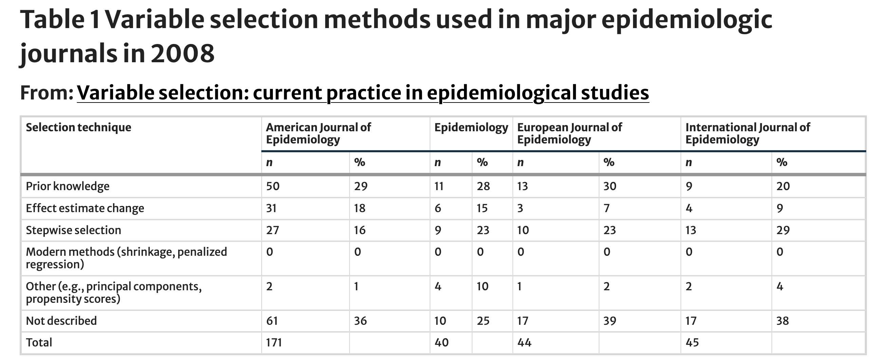
2. Adjust model by confounder: different ways
Walter, S., Tiemeier, H. Variable selection: current practice in epidemiological studies. Eur J Epidemiol 24, 733–736 (2009). https://doi.org/10.1007/s10654-009-9411-2

Slide 11
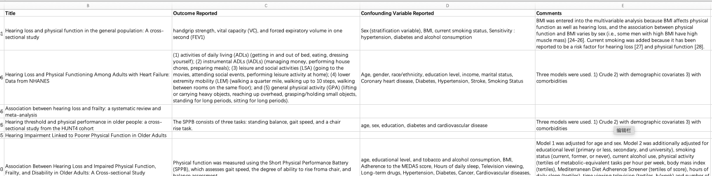
2. Adjust model by confounder: Identify Confounders from prior knowledge

Slide 12
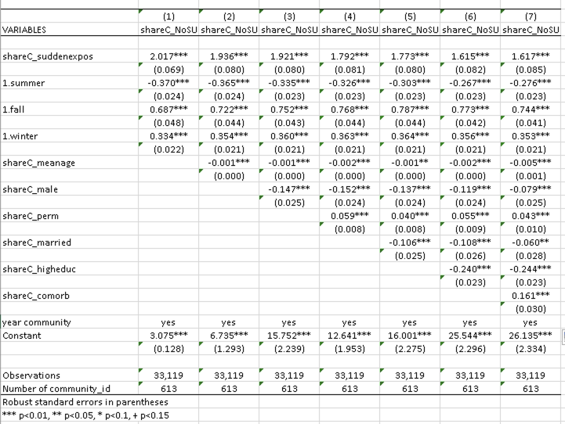
2. Adjust model by confounder: Adjust confounders step-by-step

Slide 13
2. Adjust model by confounder: fixed effect variables
Fixed effect variables are used in regression analysis to control for and eliminate unobserved individual, year effects within a model.
The fixed effect model is part of the causal inference method. It applied to the cohort database.
In association analyses, we usually add a year-fixed effect to control the effects of different years or year trends.

Slide 14
3. Sensitivity Analyses/Robustness check
Sensitivity Analyses shows whether your results are affected by measurement of the outcomes. (The audiences suspect whether you select this measurement of outcomes because it is the only version that works. Ha. )
Use different ways to determine whether your results are affected by the measure of the outcomes and see if the results remain the same as the base-case analyses.

Slide 15
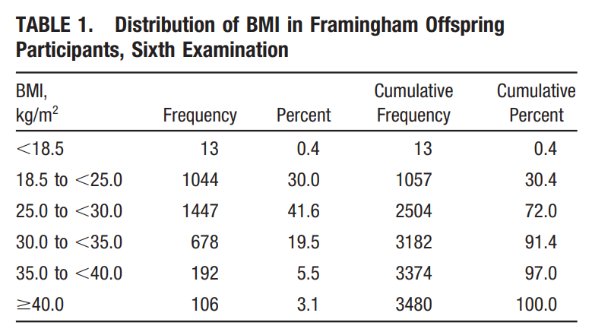
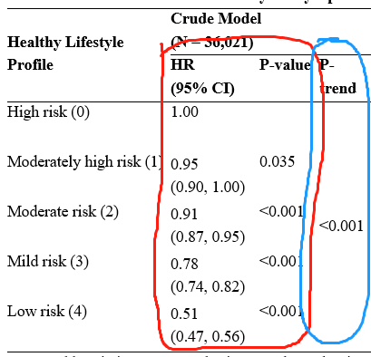
3. Sensitivity Analyses/Robustness check example
1. Switch between categorical and numerical measurement
2. Treat independent variable code = 0, 1, 2, 3, 4 as numeric score
3. Recode categorical variables
From multi-categorical to 0-1 variable.
From “have against don’t have” to ”Severe against non-severe”.

Slide 16
4. Stratification analyses/Heterogeneity analysis
Stratification analysis is a statistical technique used to control for confounding variables by dividing a study population into subgroups (strata) based on one or more characteristics. This approach allows researchers to examine the relationships between variables within each subgroup, providing insights into how the effects of interest may vary across different segments of the population.
Heterogeneity analysis is a statistical method used to explore and understand variations in treatment effects or relationships between variables across different subgroups within a population.

Slide 17
4. Stratification analyses/Heterogeneity analysis
Stratification analysis is a subgroup analysis.
Heterogeneity analysis is an interaction analysis.
Both allows subgroup differences in both intercept (constant) and slope (coefficient)

Slide 18
4. Stratification analyses

Slide 19
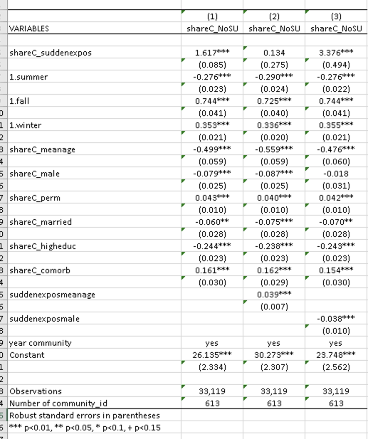
4. Heterogeneity analysis

Slide 20
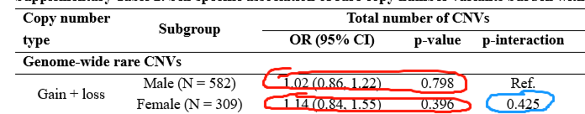
4. Stratification analyses+Heterogeneity analysis

Slide 21
*5. Mechanism Analyses
Very hard to test it with data in epidemiology analyses. Occasionally, discuss it in the discussion section.

